Slide 1

Road Accidents Analysis And Suggestions
VARUN KUMAR

Slide 2
Accident
Accident mainly occurs only due to the fault of the drivers or the person who drives the vehicle.
Accident may happen due to :
Over speed
Drunk and Drive
Not following traffic rules

Slide 3
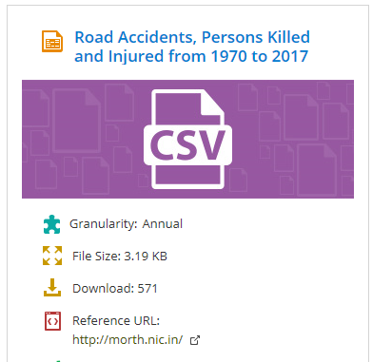
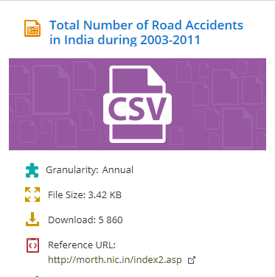
Source
https://data.gov.in

Slide 4
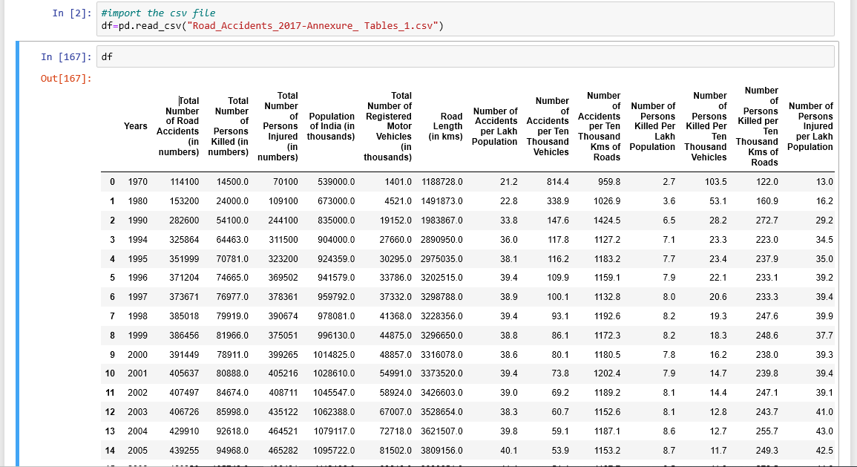
Source 1

Slide 5
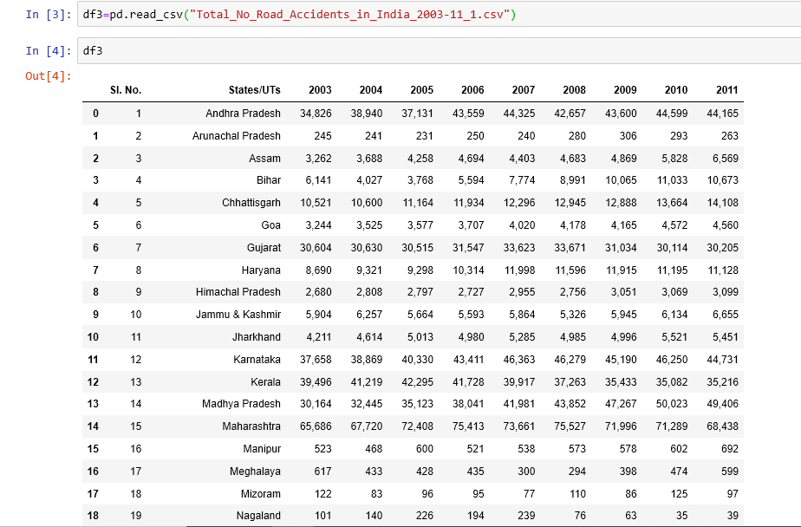
Source 2

Slide 6
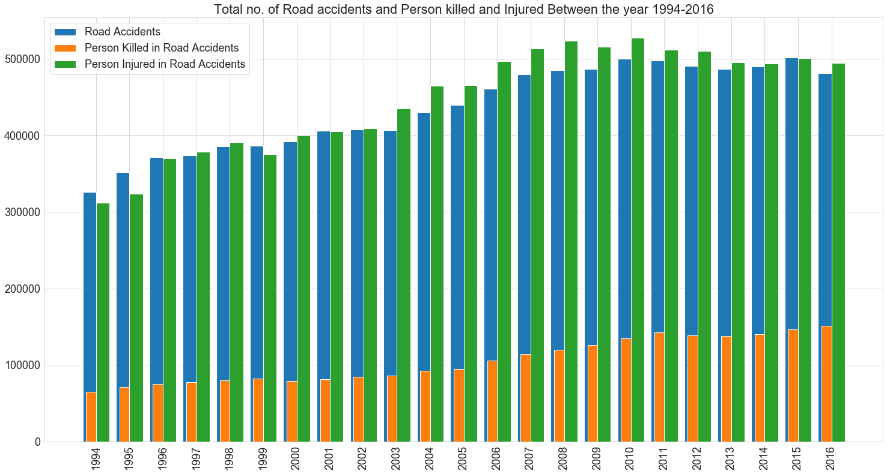
Road Accident Analysis Between the year 1994-2016

Slide 7
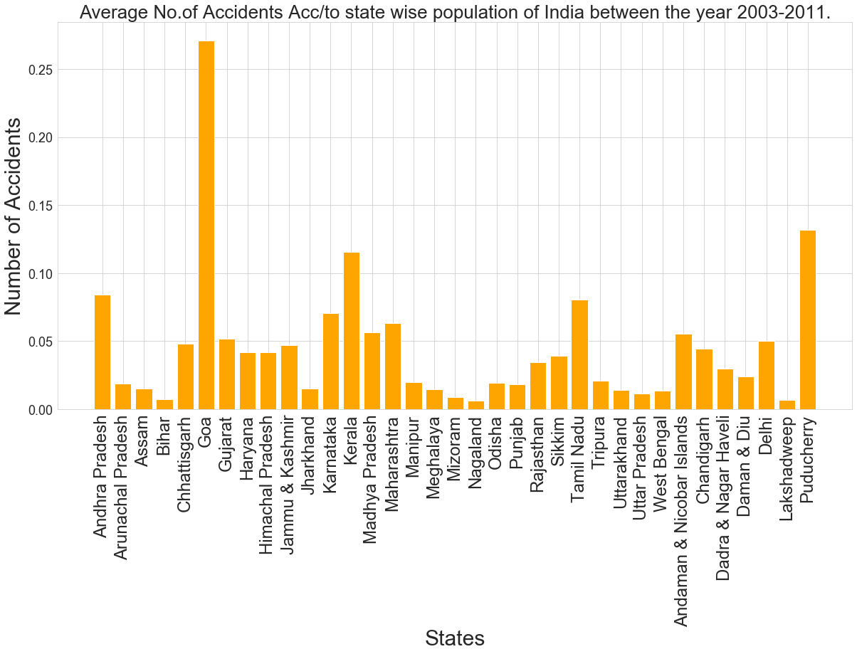
States/UTs wise Road Accidents Analysis

Slide 8
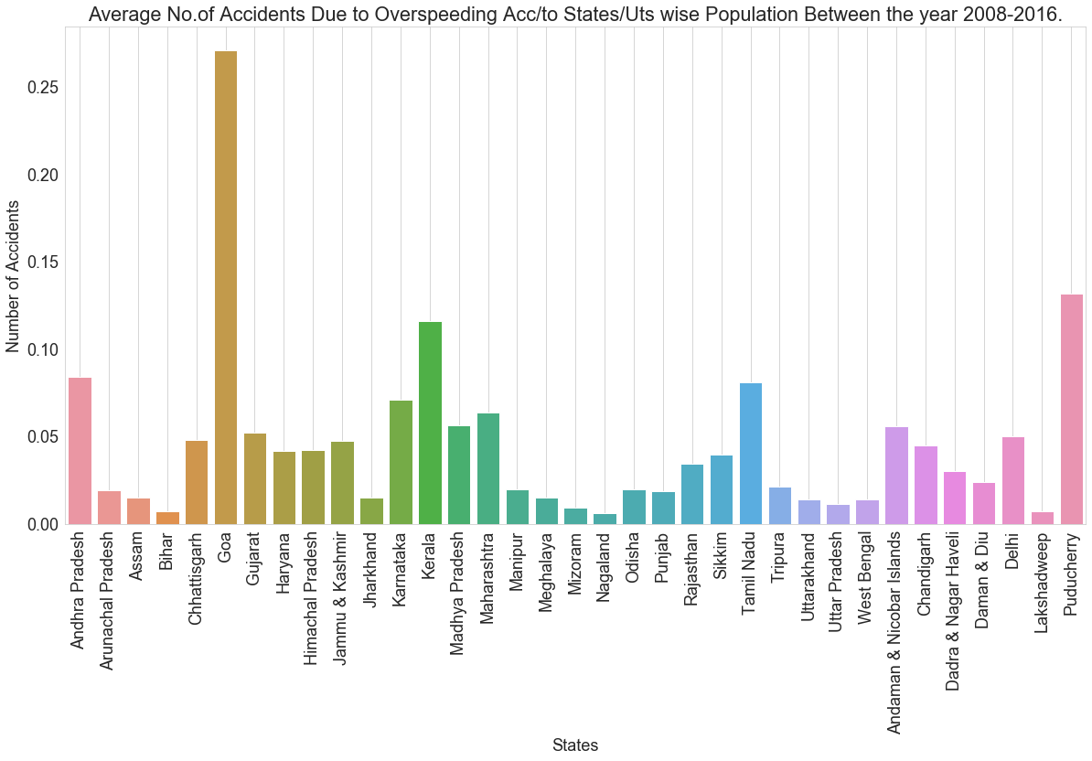
Accidents Due to OverSpeeding

Slide 9
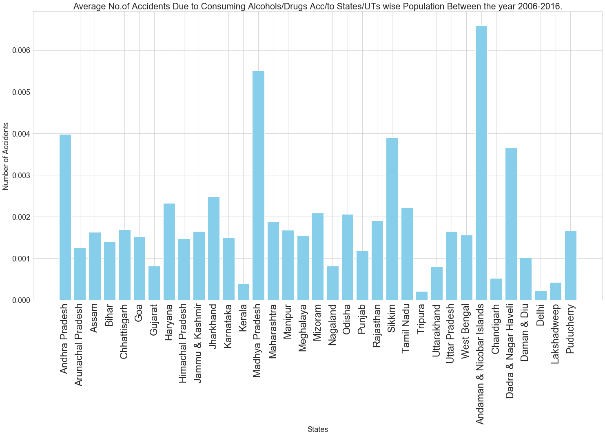
Accidents Due to Consuming Alcohols/Drugs

Slide 10
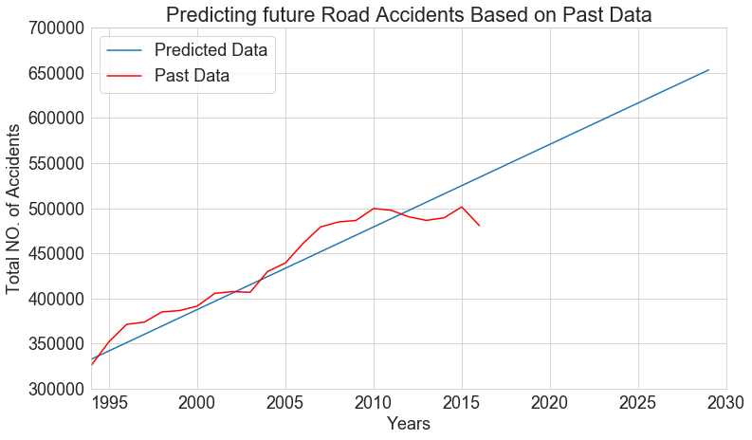

Linear Regression Model to Predict Future Road Accidents

Slide 11
Suggestions To Reduce Road Accidents
Install Over speeding cameras on the Roads.
Implement speed controller Device.
Alcohol Detector Sensor
Notes:
which aims to keep vehicle speed in check and reduce accidents.

Slide 12

Always Follow Road Saftey Rules

